Slide 1


Coffee Cafe
DIP 204 Assignment 2
Group Member : Lim Yi Wen B1500768
Ng Cheng Zhi B1600601
Leong Yue Chien B1600822
Aishath Junana Mohamed B1600576

Slide 2
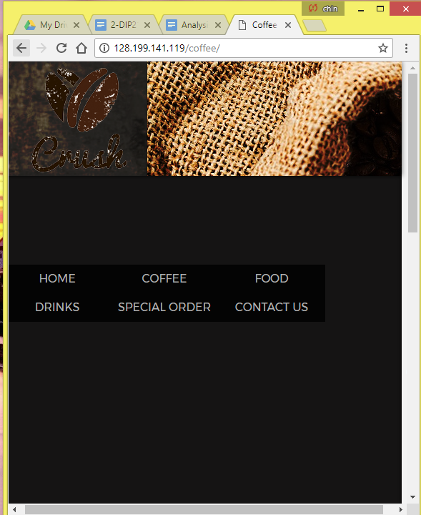
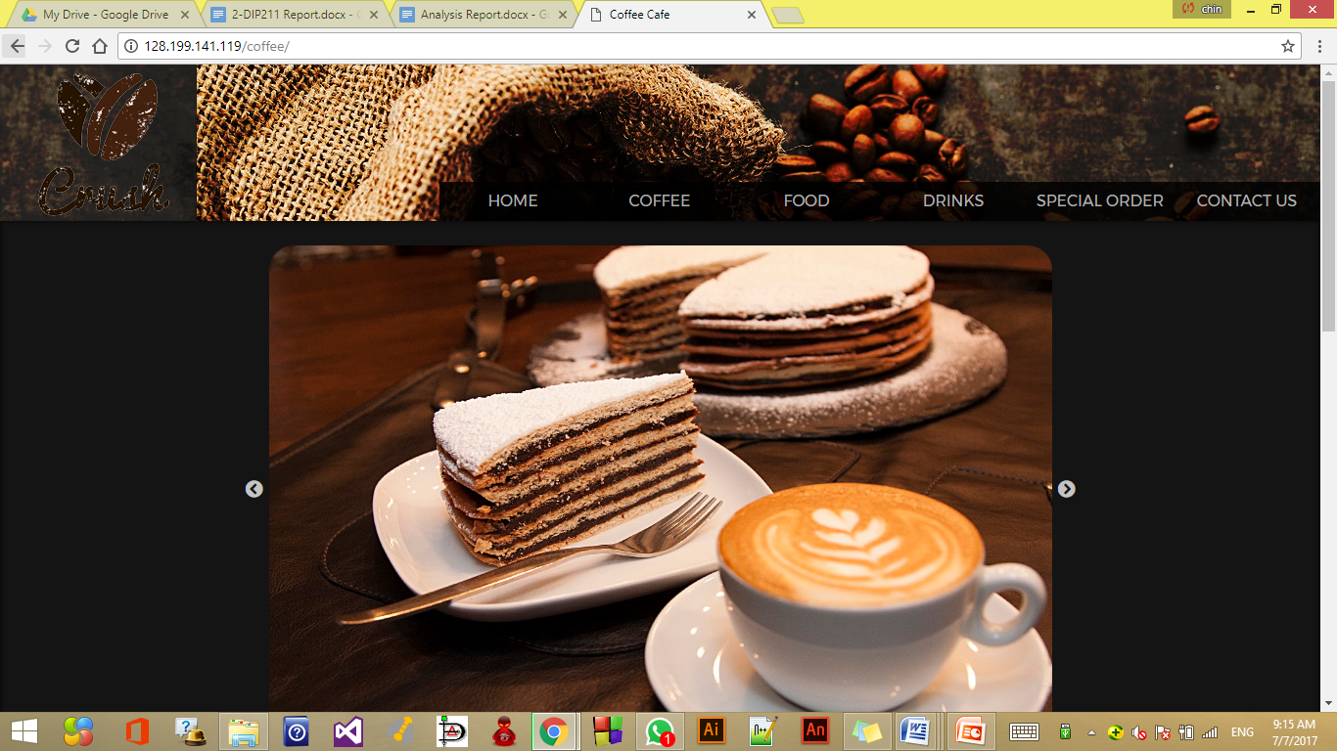
Page Layout
Jello
it has elements that stretch or adjust to the screen width while others remain fixed in width.

Slide 3

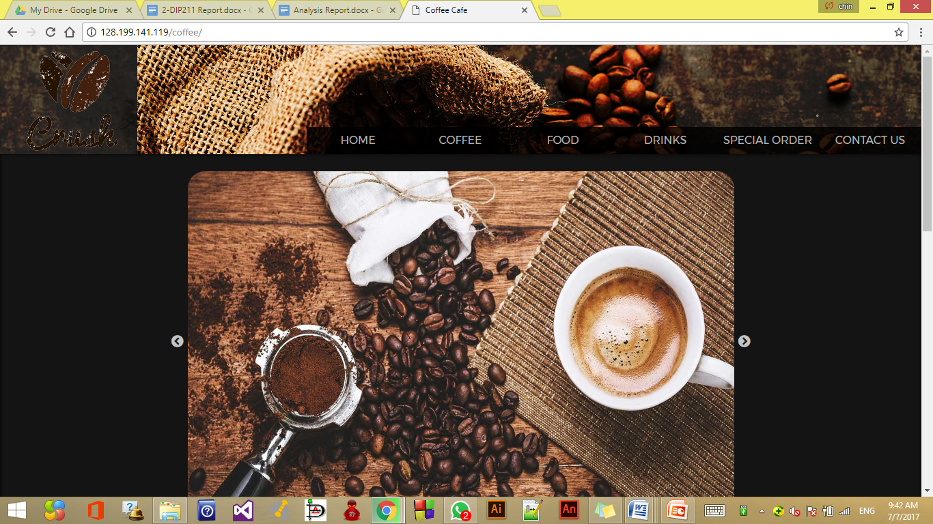
Color Scheme
Dark color
For background
represent coffee
it make the pictures pop out
#040C0E

Slide 4
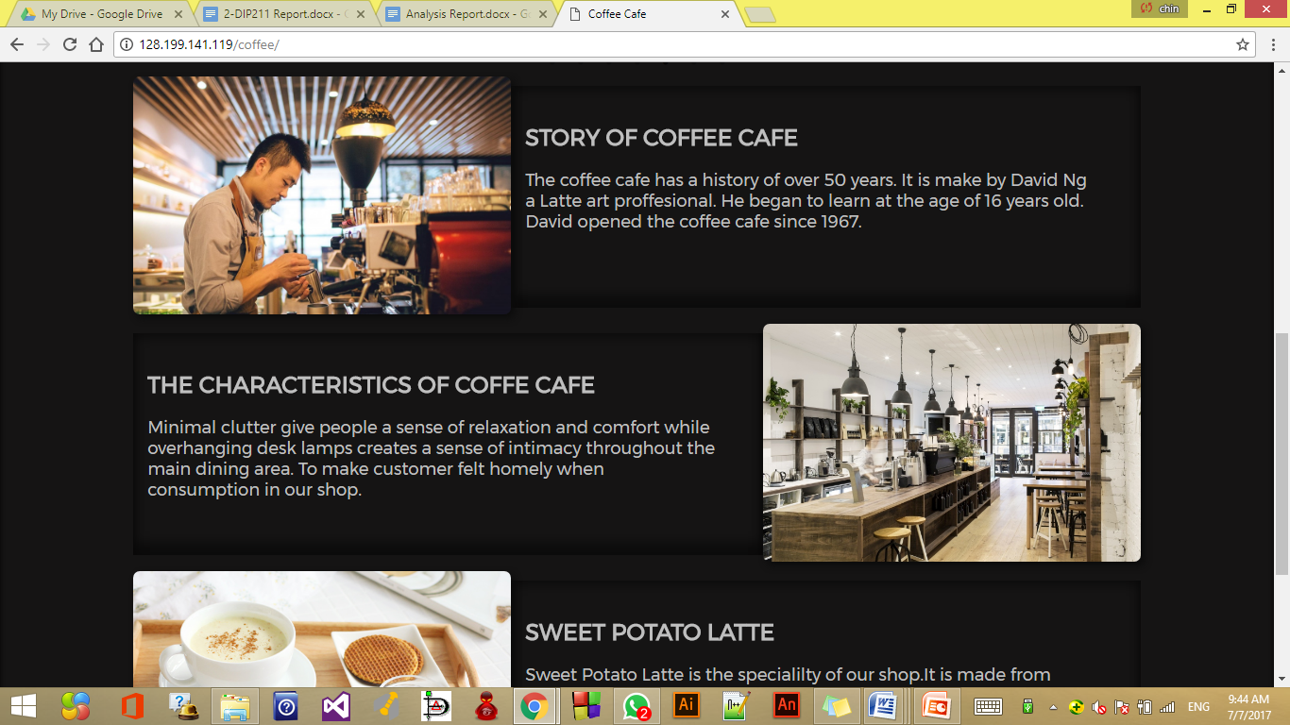

Color Scheme
Lighter color
For text
users can easy to read
#FFFFFF
Navigation

Slide 5
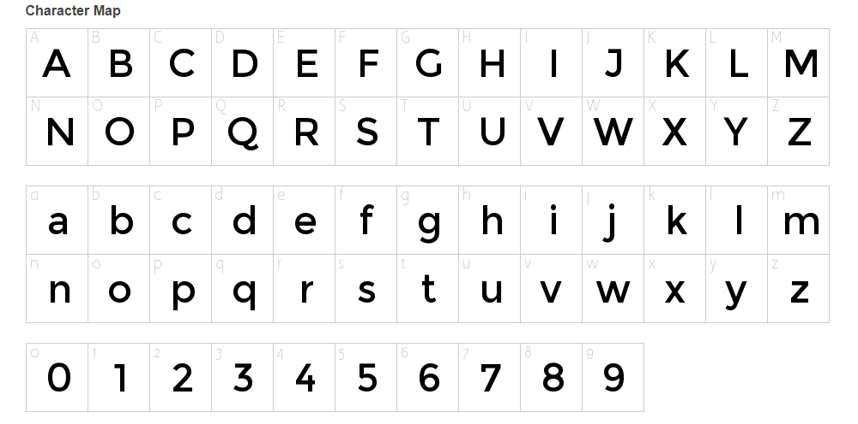
FONT face
Time New Roman
For footer
Monstserrat
a sans-serif in all
headings, subheading
and contents.

Slide 6
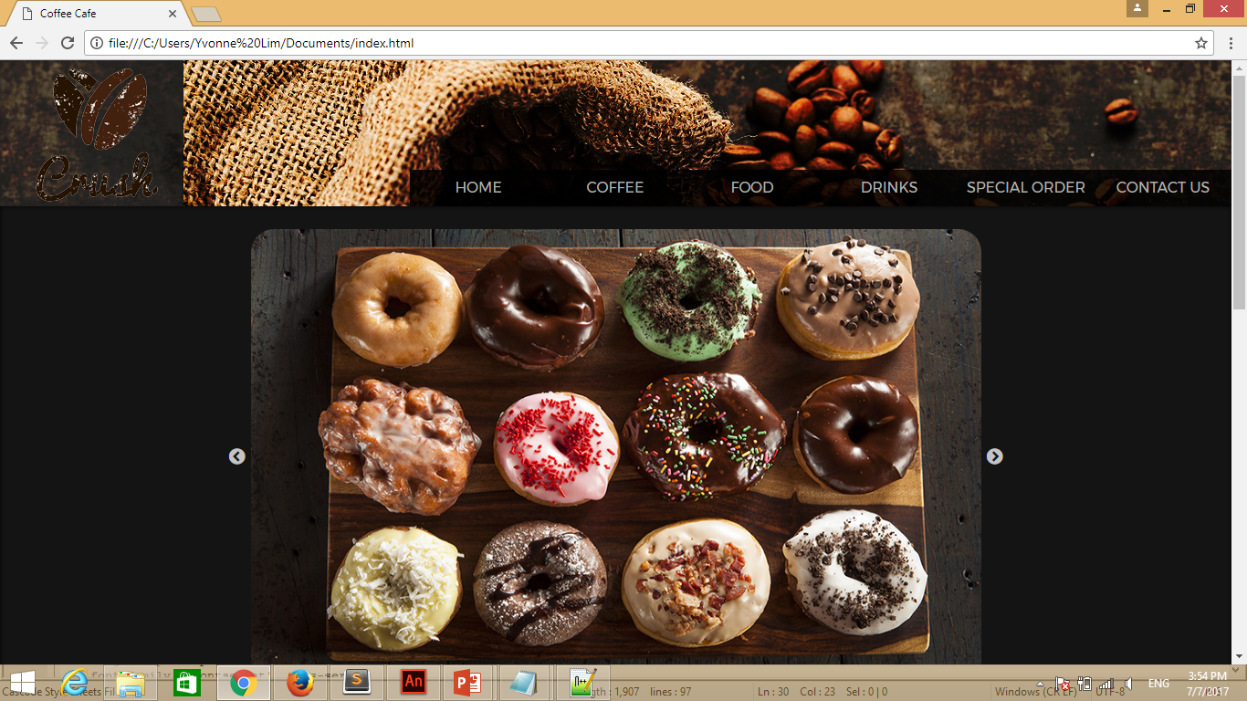
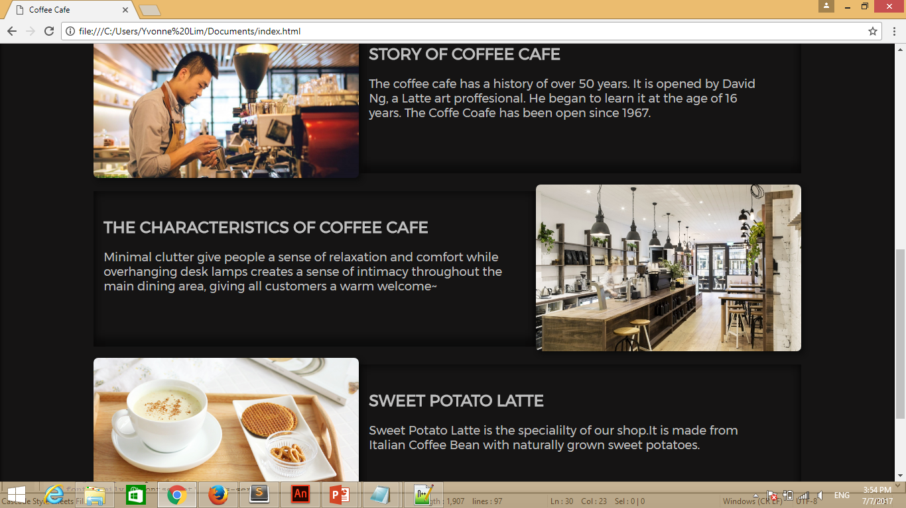
HOME PAGE

Slide 7
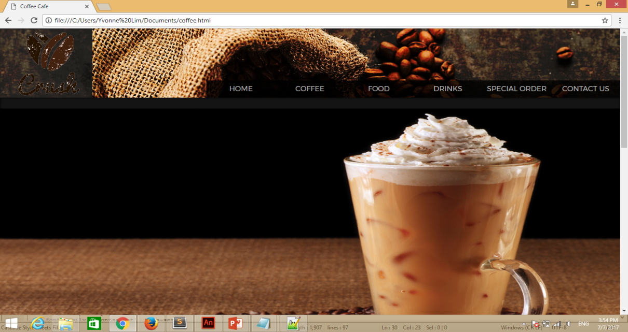
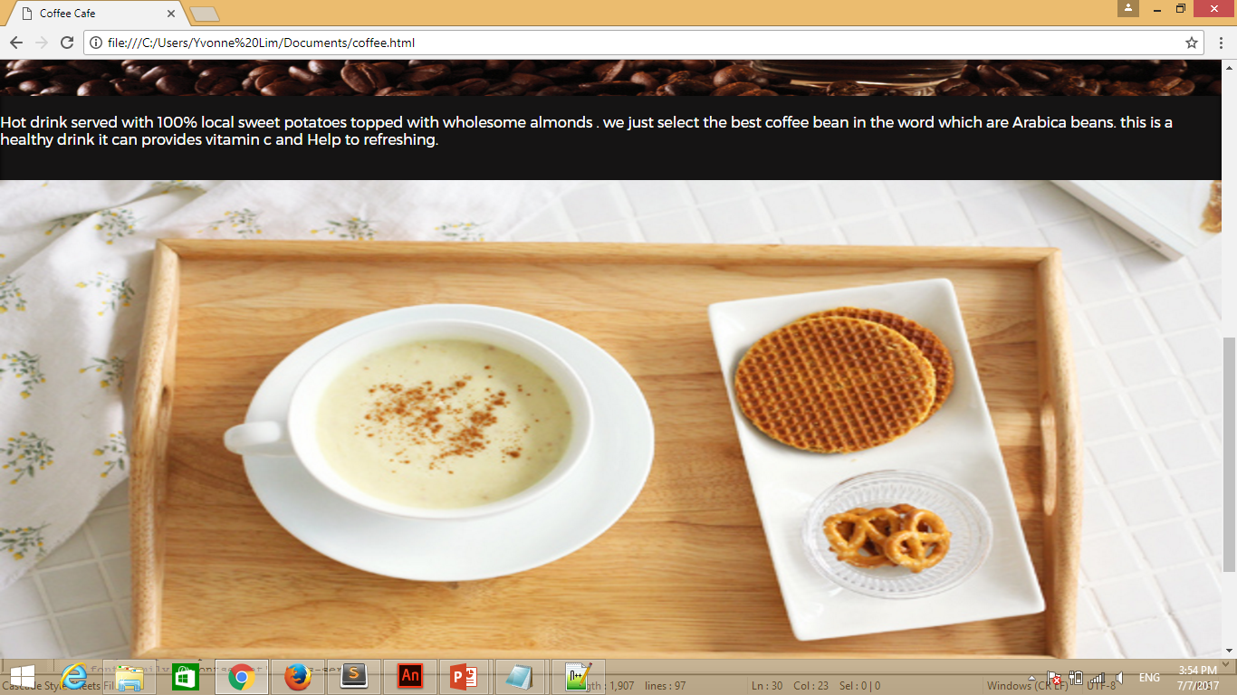
COFFEE PAGE

Slide 8
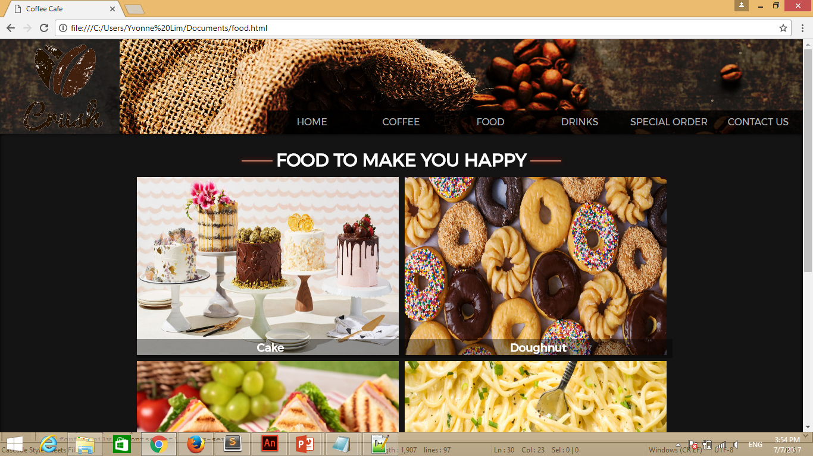
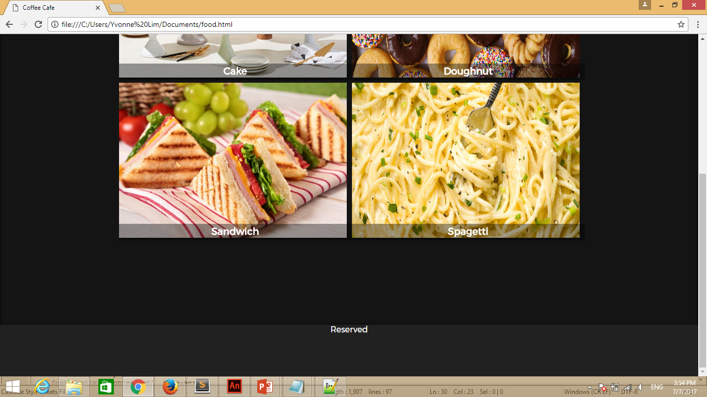
Food page

Slide 9
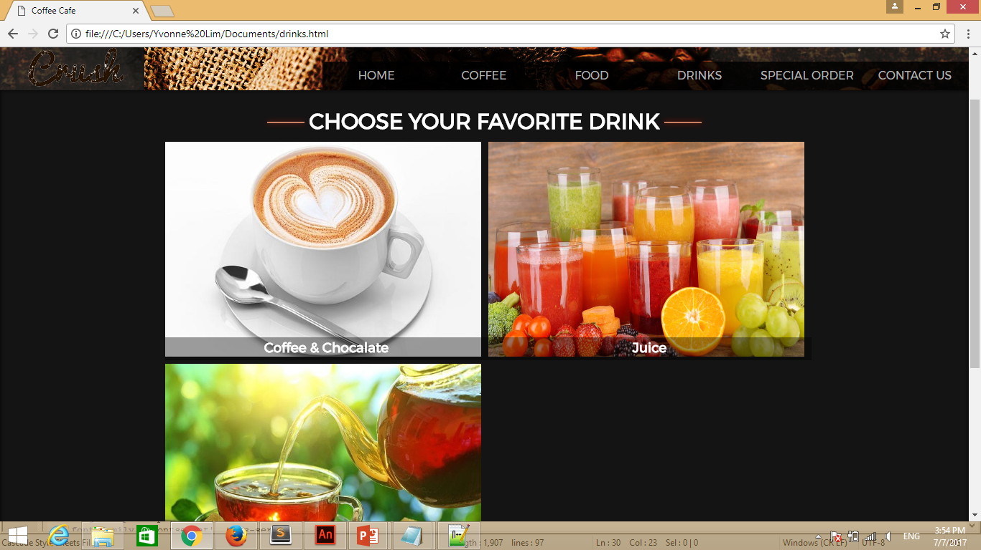
DRINK PAGE

Slide 10
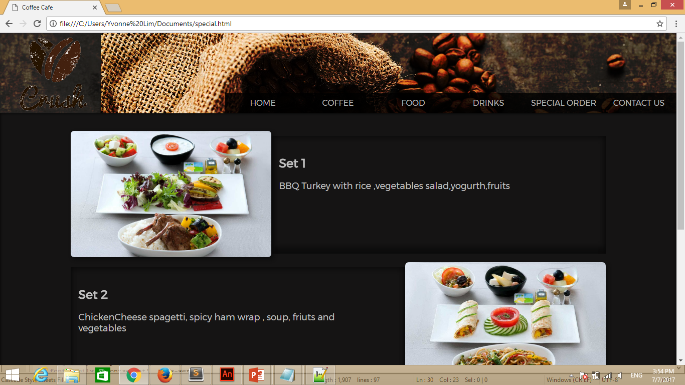
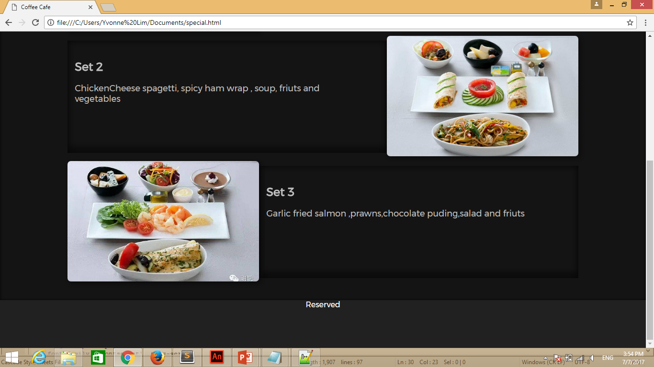
SPECIAL ORDER PAGE

Slide 11
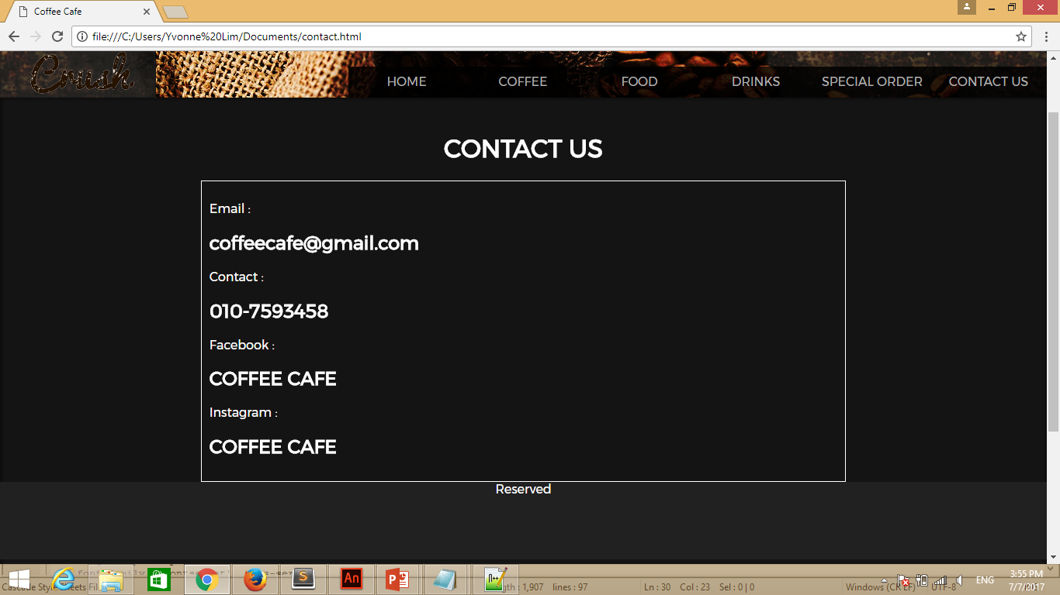
Contact page

Slide 12
Thank you

